Slide 1

Spring & Boot
Java Spring bit of theory

Slide 2
Introduction:
Spring Boot is actually very simple. My goal is to unlock its simplicity for you.
The idea is to give you the Playbook for implementing a Spring API project, running on the same K8s locally and in the cloud.
Not just give, but try it all.
Some areas we will touch superficially, but pointers for a deeper dive will be provided.

Slide 3
Agenda:
What is Spring?
What is Spring Boot?
Why Use Spring Boot?
Key Features of Spring Boot
Building Your First Spring Boot Application
Spring Boot Ecosystem
Conclusion

Slide 4
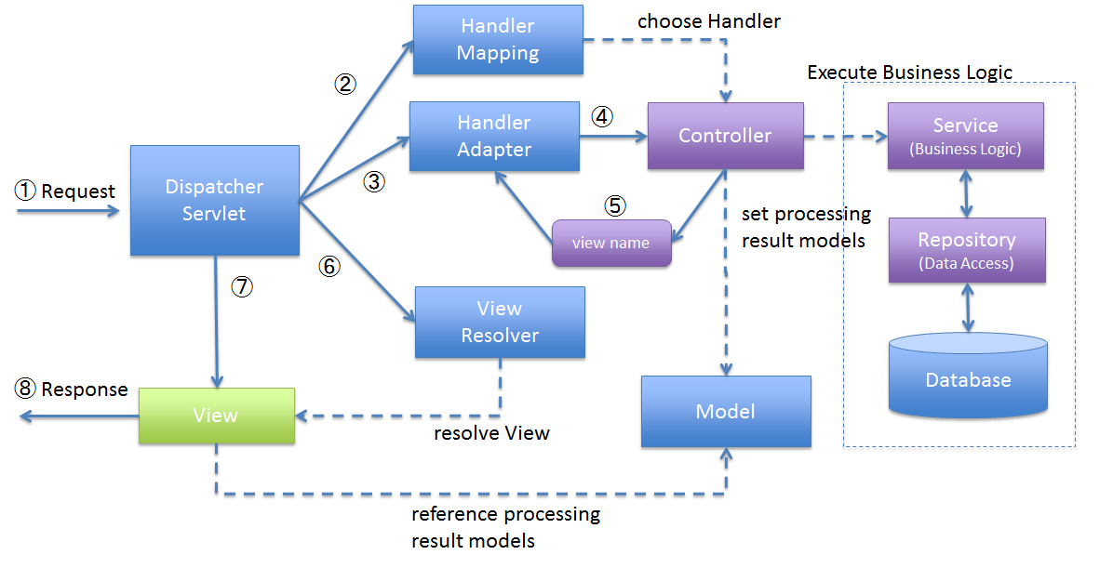

Slide 5
@Data (@Entity, @Document):
It's the same as the record type, but with the getters/setters etc.
Supports validation

Slide 6
@Repository:
Contains entities
CRUDL operations
Can be out of the box or custom
May implement CrudRepository or JpaRepository interface

Slide 7
@Controller:
Manages the views – what to read from it and what to write
Basically decides which @services to call and how to interact with them
Or which @repositories to ask for @enity requested

Slide 8
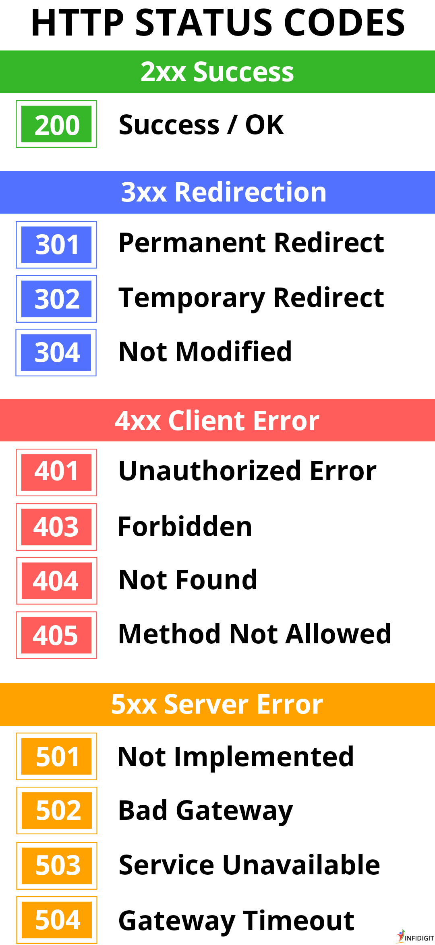
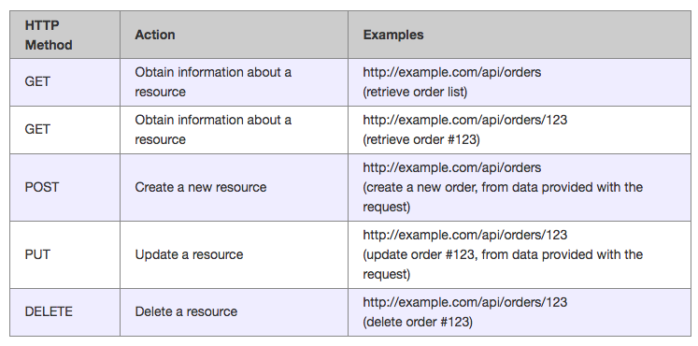
@RestController:

Slide 9
@Autowired:
Injects private field into the class using @configuration for that type
Is not recommended because its harder to mock
Replaced with the constructor injection nowadays

Slide 10
@Configuration:
Typically explains how to get an instance of the particular type instantiated
Most likely reads application configuration and calls one of the standard factory methods (builders) to create an instance for the injection

Slide 11
@Service:
Encapsulates business logic, essentially a “nano-service”
Services can call services
You can build microservices inside a monolith application
Can be injected as any other class

Slide 12
What is Spring Boot?
Spring Boot is a framework for building Java applications. Written by lazy developers for lazy developers.
It simplifies the setup and development of Java applications.
It's built on top of the Spring Framework by even lazier developers for even lazier developers:

Slide 13
Key Features of Spring Boot:
Dependency inversion – “I don’t want instantiate it, I just need an instance…”
Dependency injection – “…and I want the instance of X given to me…”
Auto-configuration – “…fully functional and ready to use”
Aspect-oriented – “…and cache results/secure etc, in one-line of code.”
Auto-Configuration: Automatically configures components based on project dependencies: “fully configured and ready to use.”
Standalone: No need for external servlet containers; Spring Boot applications can run independently.
Opinionated Defaults: Provides sensible default settings for various components.
Production-Ready: Built-in support for metrics, health checks, and externalized configuration.
Ecosystem: anything you need.

Slide 14
Why Use Spring Boot?
Rapid Development: Get started quickly with pre-built templates and a vast ecosystem.
Reduced Boilerplate Code: Spring Boot eliminates much of the repetitive setup and configuration required in traditional Java development.
Readymade solutions for typical use cases: persistence, interactions, security etc.
Microservices: Ideal for building microservices via @Service and HttpClient.
Embedded Servers: Spring Boot includes embedded servers like Tomcat and Jetty, making deployment easier.
If you need something – 99% there is a solution for it already

Slide 15
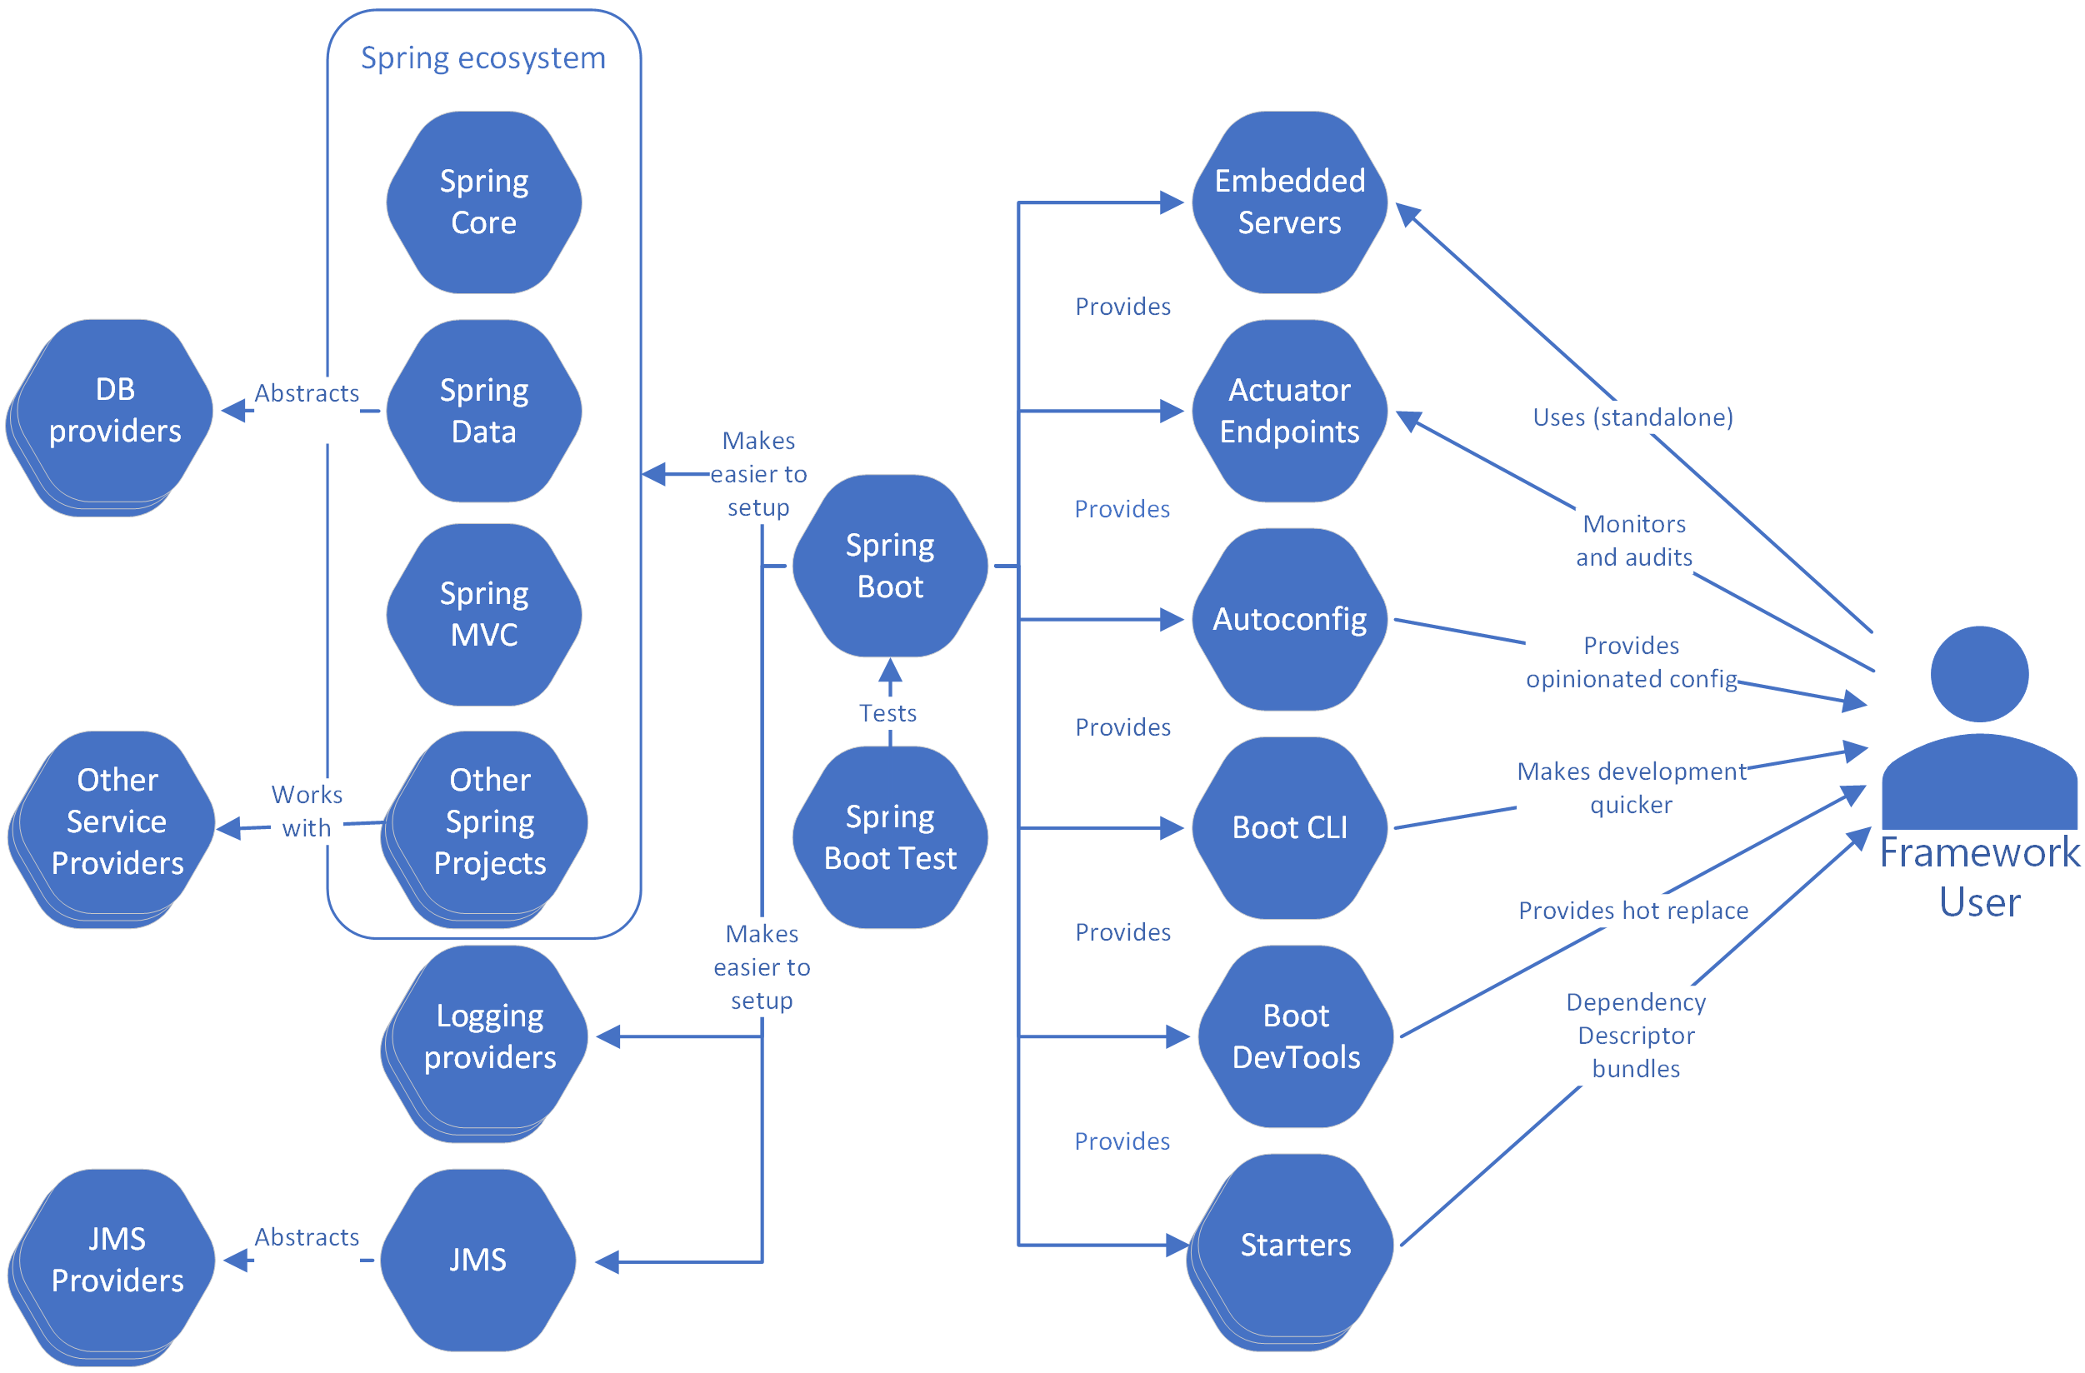
Ecosystem components:

Slide 16
12 factors for cloud-native apps:
Codebase & GitOps: Use a version control system (e.g., Git) to maintain a single codebase, and deploy the same codebase to all environments (development, staging, production, etc.).
Dependencies: Explicitly declare and isolate dependencies. Use a dependency management system to ensure consistency between development and production environments.
Config: Store configuration settings (such as database URLs, API keys, and environment-specific variables) outside the codebase. Use environment variables or a configuration management system to manage configuration.
Backing Services: Treat backing services (such as databases, message queues, and caching systems) as attached resources. Connect to these services through environment variables or service discovery mechanisms.
Build, Release, Run: Separate the build, release, and run stages of your application. This helps in managing releases and rolling back if necessary.
Processes: Run the application as one or more stateless processes. This ensures that applications are easy to scale horizontally.

Slide 17
12 factors for cloud-native apps:
Port Binding: Export services via a port binding mechanism (HTTP, TCP, etc.). This allows the application to be accessible to other services and external clients.
Concurrency: Scale the application by adding more processes (horizontal scaling) rather than making individual processes more complex. Applications should be designed to handle multiple concurrent requests.
Disposability: Make your application easy to start and stop. Use containers or other mechanisms to ensure quick and clean startup and shutdown processes.
Dev/Prod Parity: Keep development, staging, and production environments as similar as possible. This helps in detecting issues earlier in the development process.
Logs: Treat logs as event streams and store them in a central location. Use log aggregation and analysis tools to gain insights into your application's behavior.
Admin Processes: Run admin/management tasks as one-off processes. These tasks should be separate from the main application code to avoid interference with the application's core functionality.

Slide 18
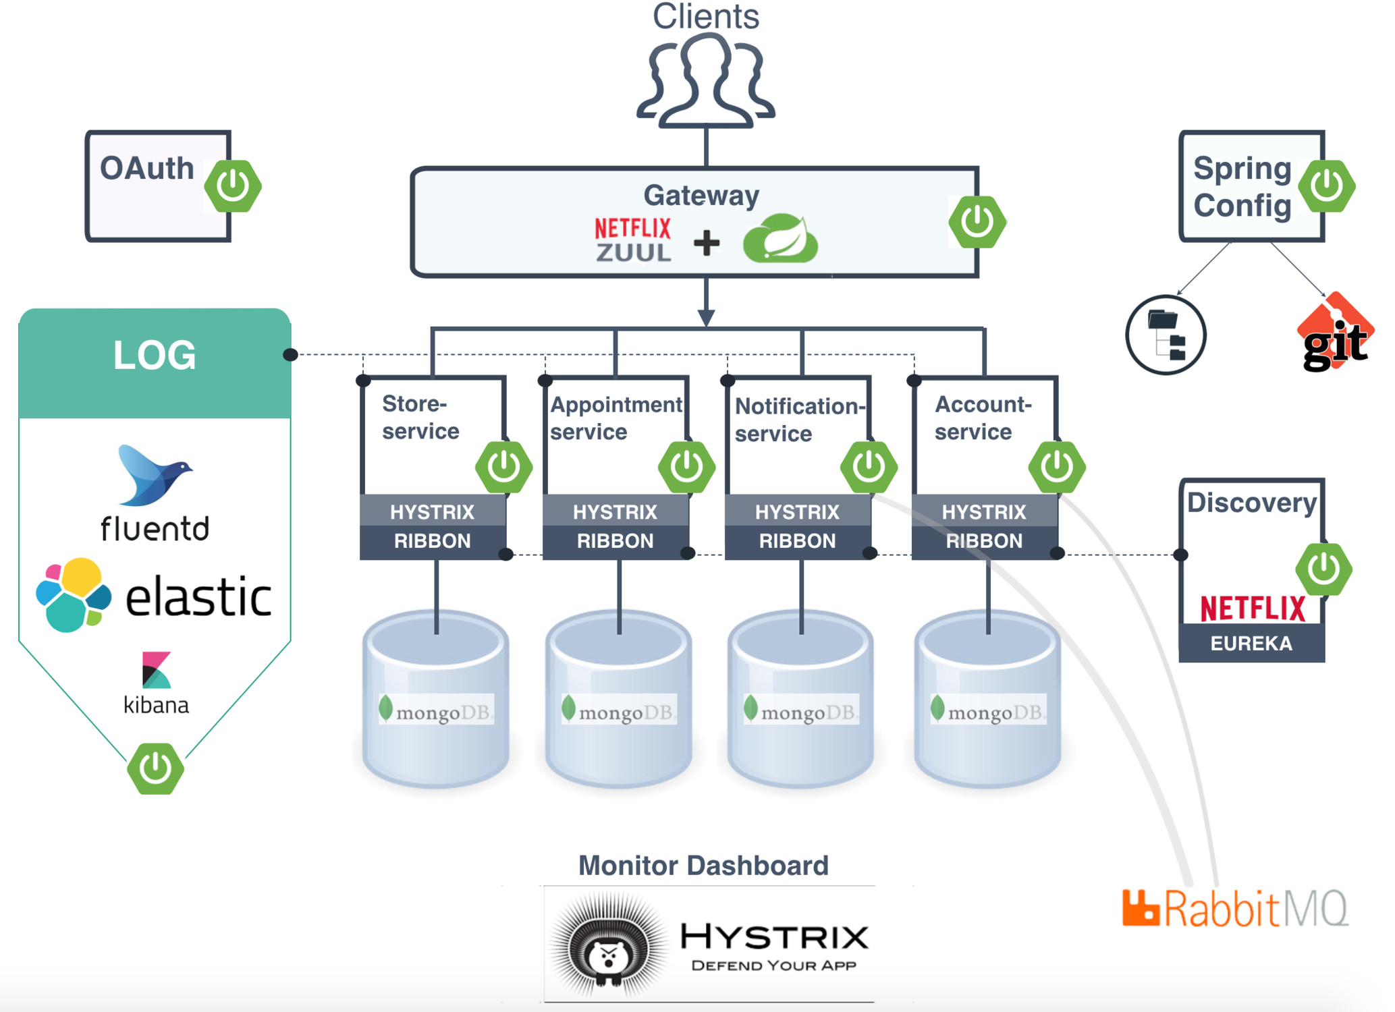
Spring Cloud
An umbrella project to build a cloud when there was no cloud
Was all-modern 10 years or so ago
You don’t need Spring Cloud to run in the cloud
Besides parts added later on to support specific cloud providers
Kubernetes provides same things (routing, centralized config, load balancing, scaling, circuit breakers) just in a different way

Slide 19
Recap
Spring provides powerful abstractions for lazy devs to build MVC apps fast…
@RestControllers uses @Repository to access @Data or call @Service
…But still requires a lot of work to wire in DB, REST rendering etc.
That’s why Spring Boot was invented by even lazier devs to:
Provide typical (but customizable) implementations for typical use cases via:
Dependency inversion & injection
Autoconfiguration
Meaningful defaults
Ecosystem libraries

Slide 20
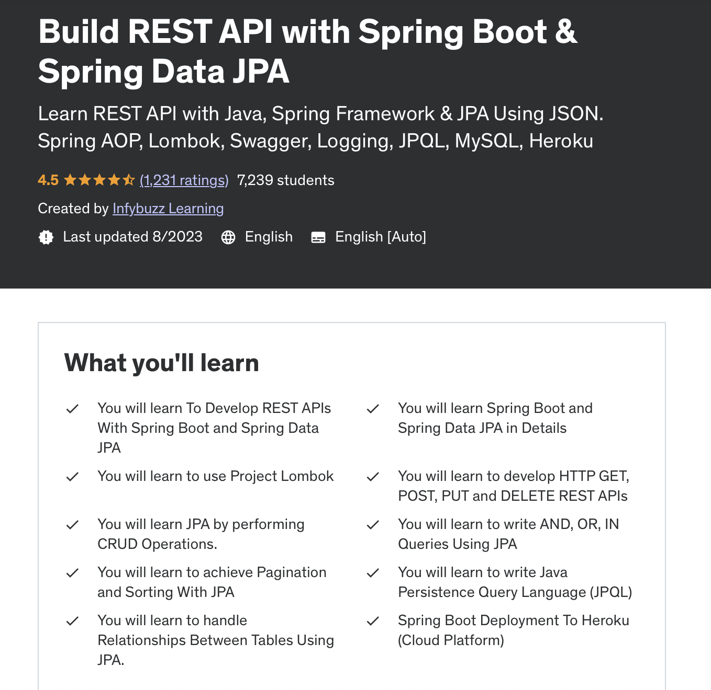
More:
https://www.udemy.com/course/rest-api-with-java-spring-boot-spring-data-jpa-jparepository-swagger/

